Slide 1
The Cognitive Psychology of Joint Action
Guenther Knoblich
Stephen Butterfill
Elisabeth Pacherie
Natalie Sebanz
Notes:
The purpose of this symposium is to discuss research on psychological mechanisms enabling joint action and to explore ways in which this research might be relevant for understanding collective intentionality.
The motivation is partly that, whereas in philosophy, social sciences and developmental psychology there is a largely shared conceptual framework and lots of common ground, in cognitive psychology things are very different. Another motivating factor is just that, as you’ll see, there are some really cool experiments.
Unfortunately Elisabeth Pacherie is unable to be here today. We are very grateful to Natalie Sebanz for agreeing to step in.
Our first speaker is Guenther Knoblich, ‘Joint Action, Hands On’

Slide 2

Motor Representation and Shared Intention s.butterfill@warwick.ac.uk
Notes:
Which events are joint actions? Nearly all philosophers and quite a few psychologists have assumed that this question can be fully answered by appeal to a special kind of intention, often called shared intention. According to them, for an event to be a joint action is for it to stand in an appropriate relation to a shared intention.

Slide 3
joint
Which events are actions?

Slide 4
joint
Which events are actions?
shared intention
joint action
R
event

Slide 5
joint
Which events are actions?
shared intention
intention
joint action
R
action
R
event
event

Slide 6
joint
Which events are actions?
shared intention
intention
joint action
R
action
R
event
event

Slide 7
joint
Which events are actions?
shared intention
intention
or motor representation
or motor representation
joint action
R
R
action
event
event
Notes:
let me just explain the reasoning here as quickly as I can ...

Slide 8
joint
Which events are actions?
shared intention
intention
or motor representation
or motor representation
or social motor representation
or social motor representation
joint action
R
R
action
event
event
Notes:
let me just explain the reasoning here as quickly as I can ...

Slide 9
premise:
Some joint actions are facilitated by
reciprocal, agent-neutral motor representations of outcomes whose obtaining would normally involve action on the part of each agent
Notes:
I’m going to start from a premise which is rightly controversial: reciprocal agent-neutral motor representation enables joint action

Slide 10
premise:
Some joint actions are facilitated by
reciprocal, agent-neutral motor representations of outcomes whose obtaining would normally involve action on the part of each agent
Notes:
I’m going to start from a premise which is rightly controversial: reciprocal agent-neutral motor representation enables joint action

Slide 11
premise:
Some joint actions are facilitated by
reciprocal, agent-neutral motor representations of outcomes whose obtaining would normally involve action on the part of each agent
Notes:
I’m going to start from a premise which is rightly controversial: reciprocal agent-neutral motor representation enables joint action

Slide 12
premise:
Some joint actions are facilitated by
reciprocal, agent-neutral motor representations of outcomes whose obtaining would normally involve action on the part of each agent
Notes:
I’m going to start from a premise which is rightly controversial: reciprocal agent-neutral motor representation enables joint action

Slide 13
premise:
Some joint actions are facilitated by
reciprocal, agent-neutral motor representations of outcomes whose obtaining would normally involve action on the part of each agent
Notes:
I’m going to start from a premise which is rightly controversial: reciprocal agent-neutral motor representation enables joint action

Slide 14
premise:
Some joint actions are facilitated by
reciprocal, agent-neutral motor representations of outcomes whose obtaining would normally involve action on the part of each agent
Notes:
I’m going to start from a premise which is rightly controversial: reciprocal agent-neutral motor representation enables joint action

Slide 15
premise:
Some joint actions are facilitated by
reciprocal, agent-neutral motor representations of outcomes whose obtaining would normally involve action on the part of each agent
=_{df} ‘social motor representation’
Notes:
I’m going to start from a premise which is rightly controversial: reciprocal agent-neutral motor representation enables joint action

Slide 16
How could social motor representation facilitate any joint action?
Notes:
How could reciprocal agent-neutral motor representation ever enable any joint action?

Slide 17
Move it from there to here
Notes:
Let’s step back and consider an individual action.
An agent moves a mug from one place to another, passing in from her left hand to her right hand half way [*demonstrate].
It’s a familiar idea that motor representations for planning and monitoring action involve an hierarchical structure,
where there is a relatively abstract representation of an outcome that is progressively filled in.

Slide 18
Move it from there to here
get it
move it
position it
hand-1
reach
grasp
move
arrive
release
hand-2
reach
grasp
move
place
release
Notes:
So motor planning involves starting with relatively abstract representations of outcomes and filling in details ...

Slide 19
Move it from there to here
get it
move it
position it
hand-1
reach
grasp
move
arrive
release
hand-2
reach
grasp
move
place
release
Notes:
And there is a need, even for a single agent, to synchronize actions in time and space; in this case because there’s an exchange between the two hands.
How is this relevant to the case of joint action?

Slide 20
joint action: same goal
Move it from there to here
get it
move it
position it
hand-1
reach
grasp
move
arrive
release
hand-2
reach
grasp
move
place
release
Notes:
In joint action the agents have the same goal, to move the object from there to here.

Slide 21
joint action: same goal
Move it from there to here
get it
move it
position it
hand-1
reach
grasp
move
arrive
release
hand-2
reach
grasp
move
place
release
similar timing problem
Notes:
They also face a similar coordination problem, requiring a precisely timed swap

Slide 22
joint action: same goal
Move it from there to here
get it
move it
position it
same planning
hand-1
reach
grasp
move
arrive
release
hand-2
reach
grasp
move
place
release
similar timing problem
Notes:
And Koutis et al’s findings (and others’ findings) suggest that the same planning in involved in the joint action case, almost up to the actual muscle contractions.
That is, in the joint action situation each agent plans both agents’ actions as if they were the actions of a single agent.
This may be what enables them to coordinate so well : each is able to plan her own actions in a way that meshes with the other agent’s actions because each agent is planning (and monitoring) both their actions almost as if a single agent were going to execute the whole action.
And of course this is exactly what we want for small-scale joint action---we want two or more agents to act as one.

Slide 23
joint action: same goal
Move it from there to here
get it
move it
position it
same planning
hand-1
reach
grasp
move
arrive
release
hand-2
reach
grasp
move
place
release
prevention needed
similar timing problem
Notes:
So what is the difference between the individual and the joint case? From the point of view of motor representation, the primary difference may be that in joint action there is a need to inhibit execution of the parts of the action which are not one’s own.
Here then is the basic idea I take to be guiding Kourtis and others.
The idea is that coordination is sometimes achieved by having each agent’s motor system plan all of their actions;
given some assumptions, this could be a way of making it likely that each will execute their part in the joint action in a way that meshes with the way the other agents execute their parts.

Slide 24
premise:
Some joint actions are facilitated by
reciprocal, agent-neutral motor representations of outcomes whose obtaining would normally involve action on the part of each agent
Notes:
Now so far I’ve only been considering a possible role for social motor representation in enabling joint action.
This leads to a question

Slide 25
joint
What is the relation between a purposive action and the outcome or outcomes to which it is directed?
Notes:
And again the question has two aspects.
What singles out the outcome or outcomes to which a purposive joint action is directed?

Slide 26

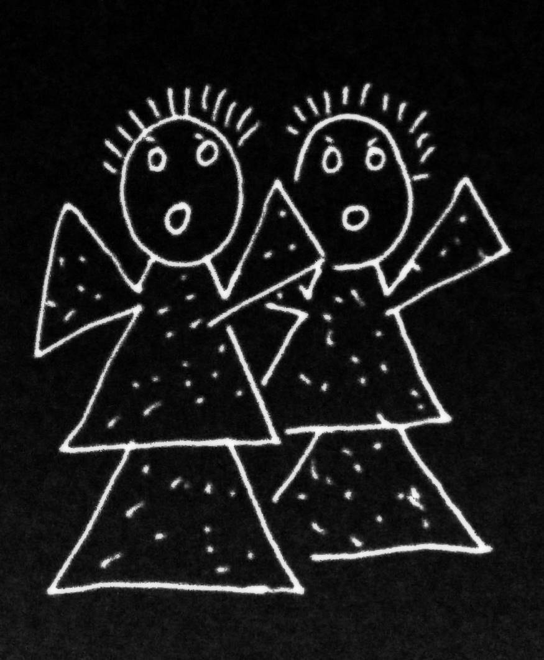
joint
What is the relation between a purposive action and the outcome or outcomes to which it is directed?
Notes:
And again the question has two aspects.
What singles out the outcome or outcomes to which a purposive joint action is directed?

Slide 27
joint
What is the relation between a purposive action and the outcome or outcomes to which it is directed?
out
joint
action
out
act
out
out
Notes:
And again the question has two aspects.
What singles out the outcome or outcomes to which a purposive joint action is directed?

Slide 28
joint
What is the relation between a purposive action and the outcome or outcomes to which it is directed?
wave
out
joint
action
out
reach
act
out
grasp
out
scratch
Notes:
And what binds together the various activities that make up the joint action?
The difference in the case of joint action is, of course, that these activities are not necessarily activities of a single agent.

Slide 29
joint
What is the relation between a purposive action and the outcome or outcomes to which it is directed?
wave
out
joint
action
out
reach
act
out
grasp
shared intention or social motor representation
out
scratch
Notes:
The answer to this question for the case of joint action is also superficially similar in the answer we gave in the case of ordinary, individual action.
A shared intention is what relates purposive joint actions to the outcomes to which they are directed.
For the shared intention
(1) involves a representation, on the part of each agent, of an outcome
(2) coordinates the several agents’ activities
and
(3) coordinates the several agents’ activities in such a way that would normally facilitate the occurrence of the represented outcome.
It is in this sense that a shared intention can ground the purposiveness of a joint action.

Slide 30
joint
What is the relation between a purposive action and the outcome or outcomes to which it is directed?
wave
out
joint
action
out
reach
act
out
grasp
shared intention or social motor representation
out
scratch
Notes:
But what we saw earlier, what the research by Kourtis et al and others indicates, is that social motor representation can play a similar role to joint action.
Return to the example of a two agents moving an object in a way that involves passing it between them.
the motor representation
(1) involves a representation, on the part of each agent, of an outcome
In this case the outcome is the whole movement of the object
(2) coordinates the several agents’ activities
and
(3) coordinates the several agents’ activities in such a that would normally facilitate the occurrence of the represented outcome.
Because each agent represents the whole movement and plans all of its implementation irrespective of which parts she will actually perform, each agent plans the action in a way that should coordinate with the other agent’s plans providing they use similar planning procedures
[*What I’m saying here, in effect, is that both shared intention and social motor representation can yield a COLLECTIVE GOAL]

Slide 31
joint
What is the relation between a purposive action and the outcome or outcomes to which it is directed?
wave
out
joint
action
out
reach
act
out
grasp
shared intention or social motor representation
out
scratch
Notes:
What I’m suggesting is very simple.
If you think that in ordinary, individual action, the purposiveness of actions can be grounded by motor representations
(and you should think this because it’s true),
then you should also think the same about actions involving two or more agents---the purposiveness of a joint action can be grounded in motor representations as well as in shared intentions.

Slide 32
Notes:
in conclusion ...
I’ve developed two ideas.
The first is that it’s a mistake to think we can fully explain what joint action is by appeal to shared intention only.
If it’s true that social motor representation enables some joint actions, then social motor representation plays a distinctive role in grounding the purposiveness of joint action.
So fully explicating joint action involves appeal to both pre-reflective and reflective structures, structures of motor representation as well as to structures of intention.
The second idea is really just a challenge.
Some joint actions involve both shared intention and social motor representation
and there is a question about how these two can ever non-accidentally harmoniously contribute to a single joint action rather than always pulling in different directions.
This question is a problem because the obvious answer---appeal to a process of planning---is blocked by the fact that shared intention and social motor representation involve different representational formats.
My very tentative suggestion was that some shared intentions may be anchored in social motor representations by means of demonstrative elements which refer to joint actions by deferring to components of social motor representations.
If that is right, experience of action has a key role to play in linking reflective and pre-reflective states and processes in joint action.

Slide 33
Two outcomes, A and B, match in a particular context just if, in that context, either the occurrence of A would normally constitute or cause, at least partially, the occurrence of B or vice versa.
Notes:
in conclusion ...
I’ve developed two ideas.
The first is that it’s a mistake to think we can fully explain what joint action is by appeal to shared intention only.
If it’s true that social motor representation enables some joint actions, then social motor representation plays a distinctive role in grounding the purposiveness of joint action.
So fully explicating joint action involves appeal to both pre-reflective and reflective structures, structures of motor representation as well as to structures of intention.
The second idea is really just a challenge.
Some joint actions involve both shared intention and social motor representation
and there is a question about how these two can ever non-accidentally harmoniously contribute to a single joint action rather than always pulling in different directions.
This question is a problem because the obvious answer---appeal to a process of planning---is blocked by the fact that shared intention and social motor representation involve different representational formats.
My very tentative suggestion was that some shared intentions may be anchored in social motor representations by means of demonstrative elements which refer to joint actions by deferring to components of social motor representations.
If that is right, experience of action has a key role to play in linking reflective and pre-reflective states and processes in joint action.

Slide 34
Two outcomes, A and B, match in a particular context just if, in that context, either the occurrence of A would normally constitute or cause, at least partially, the occurrence of B or vice versa.
We have a shared intention that we J if
“1. (a) I intend that we J and (b) you intend that we J
“2. I intend that we J in accordance with and because of la, lb, and meshing subplans of la and lb; you intend [likewise] …
“3. 1 and 2 are common knowledge between us”
(Bratman 1993: View 4)
Notes:
in conclusion ...
I’ve developed two ideas.
The first is that it’s a mistake to think we can fully explain what joint action is by appeal to shared intention only.
If it’s true that social motor representation enables some joint actions, then social motor representation plays a distinctive role in grounding the purposiveness of joint action.
So fully explicating joint action involves appeal to both pre-reflective and reflective structures, structures of motor representation as well as to structures of intention.
The second idea is really just a challenge.
Some joint actions involve both shared intention and social motor representation
and there is a question about how these two can ever non-accidentally harmoniously contribute to a single joint action rather than always pulling in different directions.
This question is a problem because the obvious answer---appeal to a process of planning---is blocked by the fact that shared intention and social motor representation involve different representational formats.
My very tentative suggestion was that some shared intentions may be anchored in social motor representations by means of demonstrative elements which refer to joint actions by deferring to components of social motor representations.
If that is right, experience of action has a key role to play in linking reflective and pre-reflective states and processes in joint action.

Slide 35
Notes:
in conclusion ...
I’ve developed two ideas.
The first is that it’s a mistake to think we can fully explain what joint action is by appeal to shared intention only.
If it’s true that social motor representation enables some joint actions, then social motor representation plays a distinctive role in grounding the purposiveness of joint action.
So fully explicating joint action involves appeal to both pre-reflective and reflective structures, structures of motor representation as well as to structures of intention.
The second idea is really just a challenge.
Some joint actions involve both shared intention and social motor representation
and there is a question about how these two can ever non-accidentally harmoniously contribute to a single joint action rather than always pulling in different directions.
This question is a problem because the obvious answer---appeal to a process of planning---is blocked by the fact that shared intention and social motor representation involve different representational formats.
My very tentative suggestion was that some shared intentions may be anchored in social motor representations by means of demonstrative elements which refer to joint actions by deferring to components of social motor representations.
If that is right, experience of action has a key role to play in linking reflective and pre-reflective states and processes in joint action.

Slide 36

We have a shared intention that we J if
“1. (a) I intend that we J and (b) you intend that we J
“2. I intend that we J in accordance with and because of la, lb, and meshing subplans of la and lb; you intend [likewise] …
“3. 1 and 2 are common knowledge between us”
(Bratman 1993: View 4)
Notes:
Let me try another way of presenting the same idea.
Here are Michael Bratman’s sufficient conditions for shared intention.
I want to suggest that social motor representation provides a parallel

Slide 37
Sufficient conditions
We have a shared intention that we J if
“1. (a) I intend that we J and (b) you intend that we J
“2. I intend that we J in accordance with and because of la, lb, and meshing subplans of la and lb; you intend [likewise] …
“3. 1 and 2 are common knowledge between us”
(Bratman 1993: View 4)
Notes:
There is a direct parallel with the first condition: in the case of motor representation, each agent represents the outcome (e.g. the movement of the object).
The key claim here is that some motor representations (i) represent outcomes, and (ii) represent the outcomes of actions not all of whose components will be executed by the agent whose motor representation it is.

Slide 38
Sufficient conditions
We have a shared intention that we J if
“1. (a) I intend that we J and (b) you intend that we J
“2. I intend that we J in accordance with and because of la, lb, and meshing subplans of la and lb; you intend [likewise] …
“3. 1 and 2 are common knowledge between us”
(Bratman 1993: View 4)
Notes:
Here there is clearly no \emph{direct} parallel.
I don’t think motor representations can represent motor representations in the way that intentions can represent intentions.
But I do think there is a parallel of sorts.
Each agent’s having a motor representation of the distributed goal of their action does ensure meshing of subplans.
What ensures this meshing is not the fact that each agent represents the others’ plans.
Rather in the case where joint actions is grounded in social motor representation, what ensures meshing of subplans is two facts (i) each agent plans all of the agents’ actions, and (ii) the agents rely on similar planning strategies (planning strategies that are sufficiently similar to ensure meshing subplans).

Slide 39
Sufficient conditions
We have a shared intention that we J if
“1. (a) I intend that we J and (b) you intend that we J
“2. I intend that we J in accordance with and because of la, lb, and meshing subplans of la and lb; you intend [likewise] …
“3. 1 and 2 are common knowledge between us”
(Bratman 1993: View 4)
Notes:
I’m less sure about a parallel to the common knowledge condition.
As I see things, the justification for supposing that shared intention involves common knowledge concerns a normative link between intention and reasons.
In acting on intentions, one should be acting for reasons.
And a consideration can only be among your reasons if you know that consideration.
So I think the need for common knowledge arises from the need to explain how another person’s intentions could be among your reasons for acting.
I don’t think this need arises in the case of motor representation because it seems to me that the sort of planning of which motor representation is an element does not involve acting for reasons in the same sense.
(In motor action, there are reasons why we do things (of course!) but these are not reasons for which we act.)
What motor joint action requires is not that your motor plans provide reasons for mine.
There just has to be a good chance that this is true relative to the costs and benefits of joint action and the alternatives to joint action.
So I think that instead of common *knowledge*, in the case of social motor representation there is a common *background* of dispositions, habits and expectations.
[***CUT but one thing that might do the work of common knowledge is a custom or habit
that would allow the agents, in their particular social context, to rely on each other’s cooperation.
In some countries this sort of thing works on public transport;
it is reasonable to take for granted that, if you are obviously struggling with a pram or suitcase, then someone nearby will help.]

Slide 40
Sufficient conditions
We have a shared intention that we J if
“1. (a) I intend that we J and (b) you intend that we J
“2. I intend that we J in accordance with and because of la, lb, and meshing subplans of la and lb; you intend [likewise] …
“3. 1 and 2 are common knowledge between us”
(Bratman 1993: View 4)
Notes:
If this is right, if social motor representations play a role analogous to the structure of intentions and knowledge which Bratman identifies as sufficient for shared intention, then this is another reason to think that motor representations can ground the purposiveness of joint action.

Slide 41
question:
Which events are joint actions?
challenge:
How could social motor representation and shared intention harmoniously contribute to joint action?
premise:
Some joint actions are facilitated by
reciprocal, agent-neutral motor representations of outcomes whose obtaining would normally involve action on the part of each agent
Notes:
in conclusion ...
I’ve developed two ideas.
The first is that it’s a mistake to think we can fully explain what joint action is by appeal to shared intention only.
If it’s true that social motor representation enables some joint actions, then social motor representation plays a distinctive role in grounding the purposiveness of joint action.
So fully explicating joint action involves appeal to both pre-reflective and reflective structures, structures of motor representation as well as to structures of intention.
The second idea is really just a challenge.
Some joint actions involve both shared intention and social motor representation
and there is a question about how these two can ever non-accidentally harmoniously contribute to a single joint action rather than always pulling in different directions.
This question is a problem because the obvious answer---appeal to a process of planning---is blocked by the fact that shared intention and social motor representation involve different representational formats.
My very tentative suggestion was that some shared intentions may be anchored in social motor representations by means of demonstrative elements which refer to joint actions by deferring to components of social motor representations.
If that is right, experience of action has a key role to play in linking reflective and pre-reflective states and processes in joint action.

Slide 42

premise:
Reciprocal agent-neutral motor representation enables some joint actions
“Simulation of another person’s action, as reﬂected in the activation of motor cortices, gets stronger the more the other is perceived as an interaction partner.”
--- Kourtis, Sebanz & Knoblich (2010, p. 4)

Slide 43
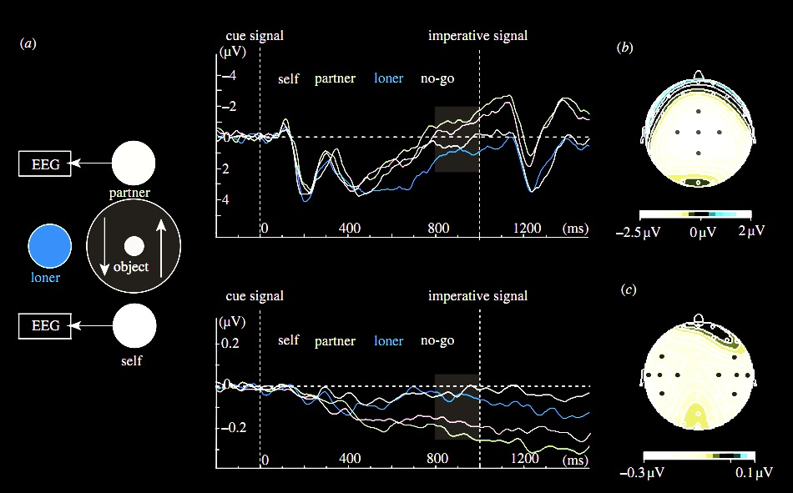
premise:
Reciprocal agent-neutral motor representation enables some joint actions
Kourtis, Sebanz & Knoblich (2010)
Notes:
Here’s the experiment they did.
The task was simple: two people sat opposite each other. Sometimes they acted alone, picking up and replacing an object. And sometimes had to act together, passing an object between them. Also present was the ‘loner’ who always acted alone.

Slide 44
premise:
Reciprocal agent-neutral motor representation enables some joint actions
Kourtis, Sebanz & Knoblich (2010)
Notes:
EEG measurements of motor activation were recorded.

Slide 45
premise:
Reciprocal agent-neutral motor representation enables some joint actions
Kourtis, Sebanz & Knoblich (2010)

Slide 46
premise:
Reciprocal agent-neutral motor representation enables some joint actions
Kourtis, Sebanz & Knoblich (2010)
Notes:
The researchers found that patterns of activation for self & joint action partner were similar, and different from patterns of activation for the actions of the loner which were similar to patterns in a ‘no go’ condition where no one was to act.

Slide 47
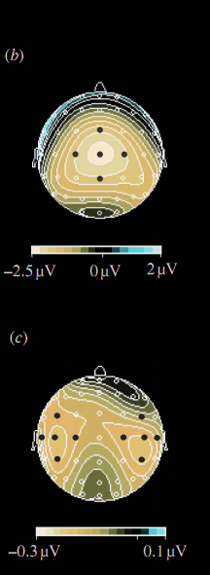
premise:
Reciprocal agent-neutral motor representation enables some joint actions
Kourtis, Sebanz & Knoblich (2010)
Notes:
So here’s what I take from this paper.
If you are engaged in a joint action with someone, one which involves moving an object by passing it between you, then each of you has motor representations of the other’s actions and these motor representations are functionally equivalent to motor representations of your own actions in the sense that they are just the sorts of representation that might have caused you to do what the other is doing (if you were in her position).

Slide 48
premise:
Reciprocal agent-neutral motor representation enables some joint actions
Kourtis, Sebanz & Knoblich (2010)
Notes:
Suppose that Kourtis et al are right that social motor representation is more likely to occur in joint action than when one is merely observing.
And suppose we take a leap and conjecture that social motor representation enables joint action
We need to ask ...

Slide 49
Notes:
Suppose that Kourtis et al are right that social motor representation is more likely to occur in joint action than when one is merely observing.
And suppose we take a leap and conjecture that social motor representation enables joint action
We need to ask ...

Slide 50
Kourtis et al., subm.

Slide 51
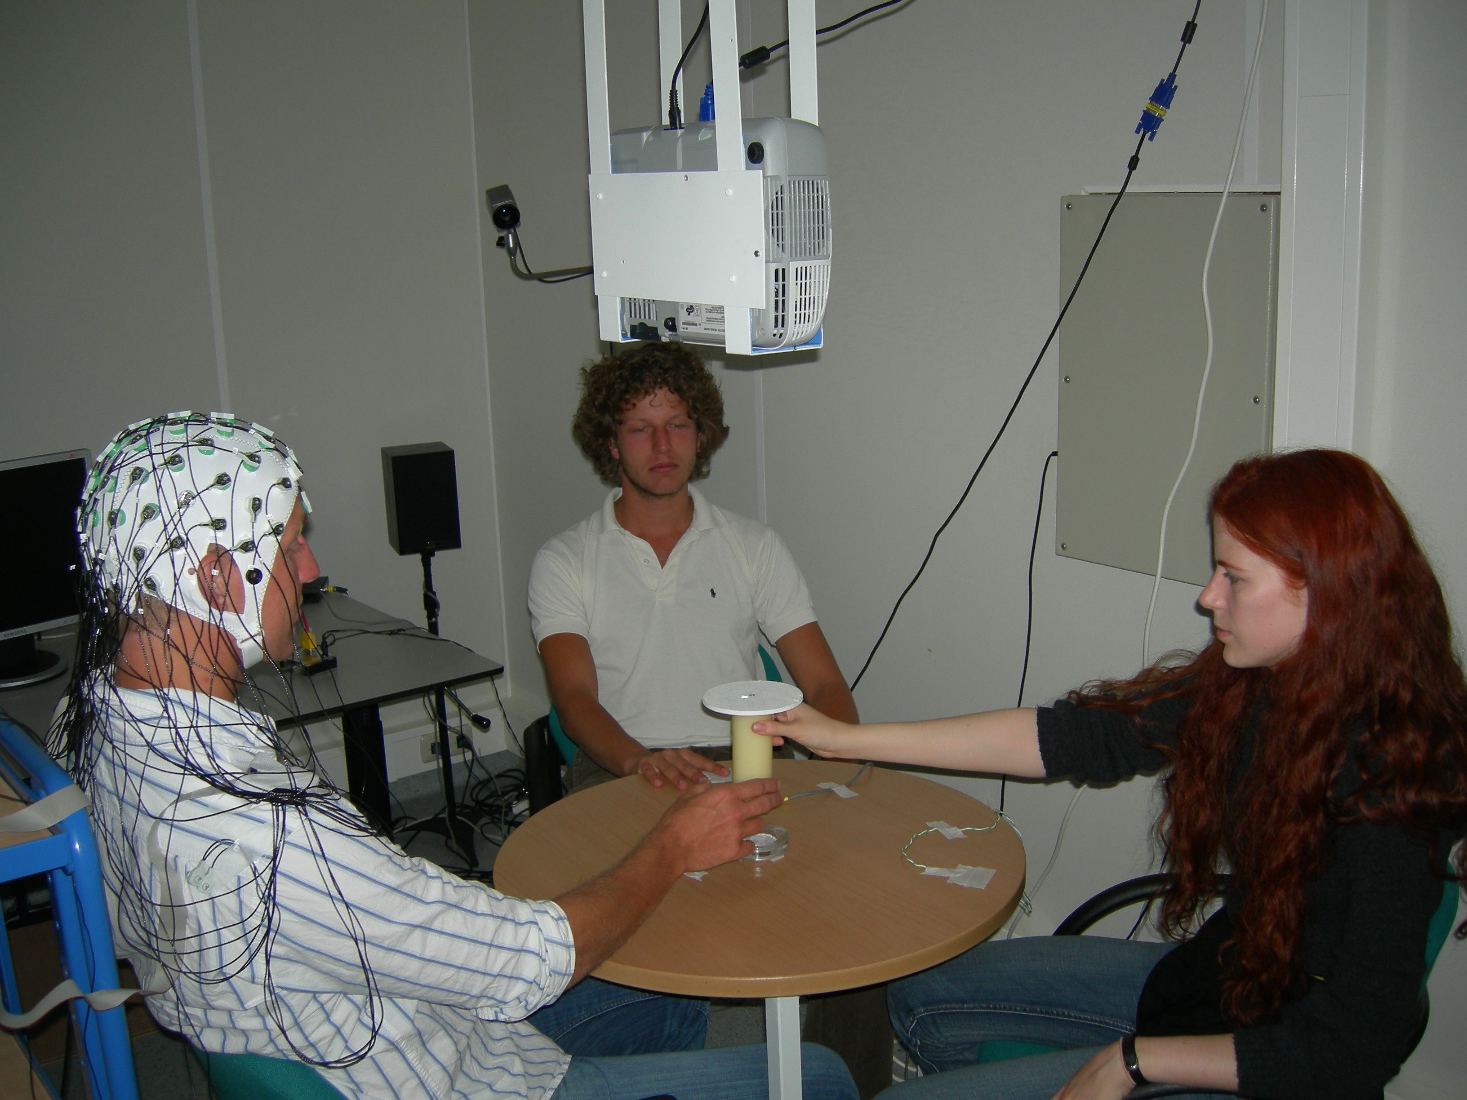
Kourtis et al., subm.

Slide 52
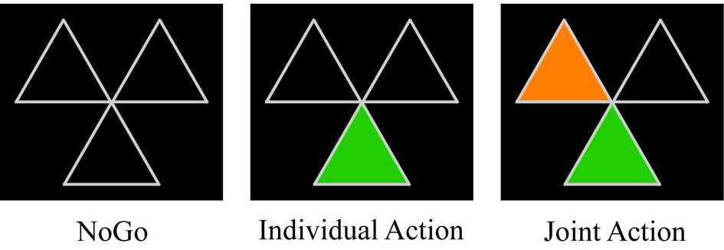
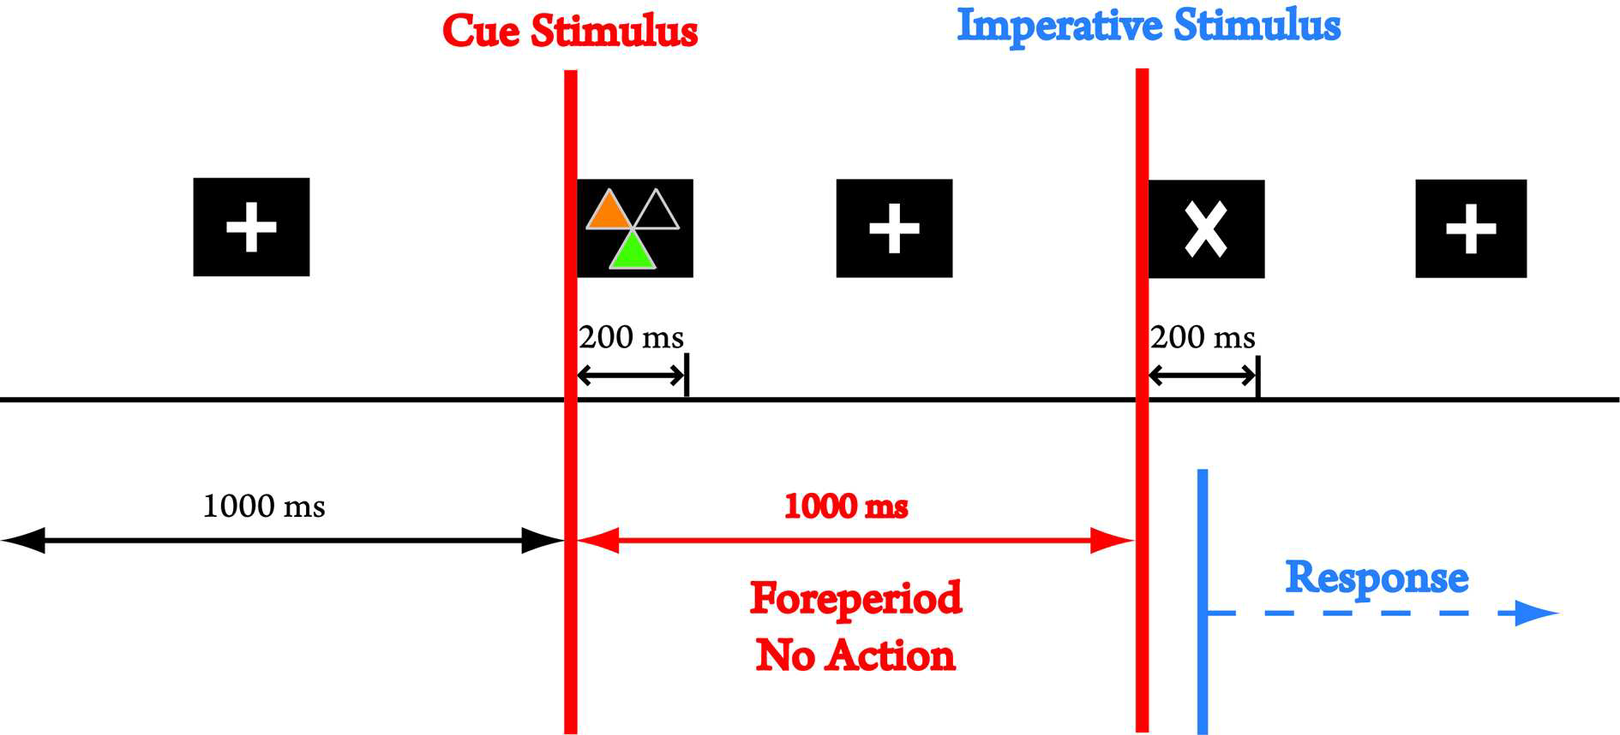
Joint Planning
Kourtis et al., subm.

Slide 53
Joint Planning
Kourtis et al., subm.

Slide 54
Joint Planning
Kourtis et al., subm.

Slide 55
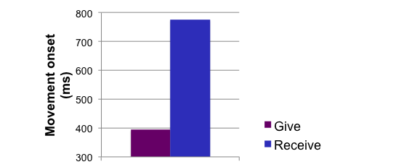
Kourtis et al., subm.

Slide 56
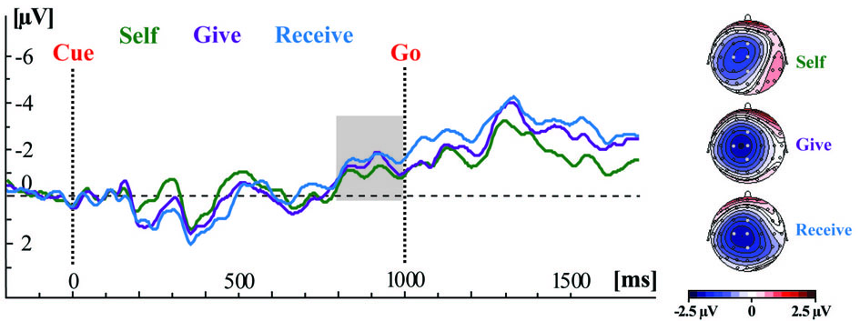
Kourtis et al., subm.

Slide 57
***ALT OPENING
The idea was to start with the most direct question (instead of events, about the relation of directedness.)

Slide 58
joint
What is the relation between a purposive action and the outcome or outcomes to which it is directed?

Slide 59
joint
What is the relation between a purposive action and the outcome or outcomes to which it is directed?

Slide 60
joint
What is the relation between a purposive action and the outcome or outcomes to which it is directed?
out
joint
action
out
act
out
out
Notes:
And again the question has two aspects.
What singles out the outcome or outcomes to which a purposive joint action is directed?

Slide 61
joint
What is the relation between a purposive action and the outcome or outcomes to which it is directed?
out
joint
action
out
act
out
out
Notes:
And again the question has two aspects.
What singles out the outcome or outcomes to which a purposive joint action is directed?

Slide 62
joint
What is the relation between a purposive action and the outcome or outcomes to which it is directed?
wave
out
joint
action
out
reach
act
out
grasp
out
scratch
Notes:
And what binds together the various activities that make up the joint action?
The difference in the case of joint action is, of course, that these activities are not necessarily activities of a single agent.

Slide 63
joint
What is the relation between a purposive action and the outcome or outcomes to which it is directed?
wave
out
joint
action
out
reach
act
out
grasp
shared intention or social motor representation
out
scratch
Notes:
The answer to this question for the case of joint action is also superficially similar in the answer we gave in the case of ordinary, individual action.
A shared intention is what relates purposive joint actions to the outcomes to which they are directed.
For the shared intention
(1) involves a representation, on the part of each agent, of an outcome
(2) coordinates the several agents’ activities
and
(3) coordinates the several agents’ activities in such a that would normally facilitate the occurrence of the represented outcome.
It is in this sense that a shared intention can ground the purposiveness of a joint action.

Slide 64
joint
What is the relation between a purposive action and the outcome or outcomes to which it is directed?
wave
out
joint
action
out
reach
act
out
grasp
shared intention or social motor representation
out
scratch
Notes:
Of course this story is only as good as our account of shared intention. But let’s not worry about that here.
Suppose we have a completely convincing account of shared intention. Still we can ask, is this the whole story about joint action?
The story is based on a parallel between joint action and ordinary individual action.

Slide 65
***CUT
Following can be used to explain idea about motor representation and ordinary, individual intention (not essential?)

Slide 66
What is the relation between a purposive action and the outcome or outcomes to which it is directed?
out
action
out
act
out
out
Notes:
A basic question about ordinary, individual action is:
What is the relation between a purposive action and the outcome or outcomes to which it is directed?
Many ordinary purposive actions have many different outcomes.
Grabbing little Isabel by the hands I swing her around, causing her to laugh and, simultaneously, breaking a vase.
In fact the outcome to which this purposive action was directed might not be among its actual outcomes; after all, actions can fail.

Slide 67
What is the relation between a purposive action and the outcome or outcomes to which it is directed?
out
action
out
out
act
out
out
Notes:
So among all the actual and possible outcomes of my action, one or some are singled out as specially related to this action.
One aspect of the question concerns what singles out the outcome or outcomes, actual or merely possible, to which a particular purposive is directed.
But there is also a second aspect ...

Slide 68
What is the relation between a purposive action and the outcome or outcomes to which it is directed?
wave
out
action
out
reach
act
out
grasp
out
scratch
Notes:
Ordinary purposive actions are sometimes composed of more than one motor action. My swinging Isabel around starts with my reaching for her wrists, grasping them and then spinning us around ... and my action doesn’t include other things which I might be doing simultaneously, like refusing a cup of tea with my eyes or trying to determine whether that smell is coming from Isabel’s sister Hannah’s nappy.

Slide 69
What is the relation between a purposive action and the outcome or outcomes to which it is directed?
wave
out
action
out
reach
act
out
grasp
out
scratch
Notes:
So another aspect of our question is what determines which activities comprise the purposive action and which do not.

Slide 70
What is the relation between a purposive action and the outcome or outcomes to which it is directed?
wave
out
action
out
reach
act
out
grasp
intention or motor representation
out
scratch
Notes:
The standard answer to this question involves intention.
An intention (1) represents an outcome, (2) coordinates the one or several activities which comprise the action; and (3) coordinate these activities in a way that would normally facilitate the outcome’s occurrence.
What binds particular component actions together into larger purposive actions? It is the fact that these actions are all parts of plans involving a single intention.
What singles out an actual or possible outcome as one to which the component actions are collectively directed? It is the fact that this outcome is represented by the intention.
So the intention is what binds component actions together into purposive actions and links the action taken as a whole to the outcomes to which they are directed.

Slide 71
What is the relation between a purposive action and the outcome or outcomes to which it is directed?
wave
out
action
out
reach
act
out
grasp
intention or motor representation
out
scratch
Notes:
Now as Elisabeth Pacherie has argued (and I’ve had a go at arguing this in joint work with Corrado Sinigaglia recently too),
motor representations are relevantly similar to intentions.
Of course motor representations differ from intentions in some important ways (as Pacherie also notes).
But they are similar in the respects that matter for explaining the purposiveness of action.
(1) Like intentions, some motor representations represent outcomes (and not merely patters of joint displacement, say).
(2) Like intentions, some motor representations play a role in coordinating multiple more component activities by virtue of their role as elements in hierarchically structured plans.
(3) And, like intentions, some motor representations coordinate these activities in a way that would normally facilitate the outcome’s occurrence.
So in the individual case, it seems to me quite straightforward that there is a role for motor representation to play in explaining the purposiveness of action [*explaining the possibility of purposive action?].
The claim is not that \emph{all} purposive actions are linked to outcomes by motor representations, just that some are.
In some cases, the purposiveness of an action is grounded in a motor representation of an outcome; in other cases it is grounded in an intention.
And of course in many cases it may be that both intention and motor representation are involved.

Slide 72
joint
Which events are actions?
shared intention
intention
or motor representation
or motor representation
or social motor representation
or social motor representation
joint action
R
R
action
event
event
Notes:
let me just explain the reasoning here as quickly as I can ...

Slide 73
Which events are joint actions?
shared intention
intention
or motor representation
or motor representation
joint action
R
R
action
event
event

Slide 74
Which events are joint actions?
shared intention
intention
or motor representation
or motor representation
or ???
or ???
joint action
R
R
action
event
event

Slide 75
***more cuts

Slide 76
question:
Which events are joint actions?
challenge:
How could social motor representation and shared intention harmoniously contribute to joint action?
premise:
Some joint actions are facilitated by
reciprocal, agent-neutral motor representations of outcomes whose obtaining would normally involve action on the part of each agent
Notes:
The question is: Does social motor representation also play a role in explaining what joint is?
I think we the details already give us grounds for a positive answer, for holding that motor representation has a role to play in explaining what joint action is.
How does this work?
Let’s go back to individual action for a moment again.

Slide 77
What is the relation between a purposive action and the outcome or outcomes to which it is directed?
wave
out
action
out
reach
act
out
grasp
intention or motor representation
out
scratch
Notes:
Now let’s turn to joint action.

Slide 78
joint
What is the relation between a purposive action and the outcome or outcomes to which it is directed?
wave
out
action
out
reach
act
out
grasp
intention or motor representation
out
scratch
Notes:
The same question we asked about ordinary, individual action also arises for joint action.
What is the relation between a purposive joint action and the outcome or outcomes to which it is directed?

